Slide 1
FINAL CAPSTONE PRESENTATION | DAY 7
Uber Eats
Operational & Customer Intelligence
Segmentation • Sentiment Analysis • Delivery-Time Prediction • Demand Forecasting
Presented by: Hari Hara Chowdary
Trainee Data Analyst
A machine-learning demonstration built on synthetic project datasets

Slide 2
UBER EATS • CAPSTONE
Executive summary: four analytical workstreams
SOURCE ORDERS
CUSTOMER BASE
REVIEWS ANALYSED
COMPLETED DELIVERIES
1,800
300
1,147
1,624
7 source tables
45 restaurants • 70 drivers
Average rating: 3.67 / 5
Of 1,800 delivery records
Segmentation: 3 customer clusters and 3 restaurant clusters identified with K-Means.
Delivery-time model: Ridge achieved 3.94-minute test MAE and R² = 0.906.
Sentiment: 59.8% positive, 28.5% neutral and 11.7% negative reviews.
Forecasting: ARIMA slightly outperformed Prophet, but both had high MAPE (~33–37%).
Synthetic demonstration data • Results from supplied project outputs
02

Slide 3
UBER EATS • CAPSTONE
Business problem & project questions
THE BUSINESS CHALLENGE
QUESTIONS THIS PROJECT ADDRESSES
How can a food-delivery platform better understand customers, improve service, anticipate delivery times and plan capacity?
Which customer and restaurant groups behave differently?
What themes appear in customer feedback?
Which operational factors are associated with delivery duration?
Can hourly order demand be forecast for short-term planning?
Scope: analytical proof of concept using synthetic data—not production Uber Eats data.
Synthetic demonstration data • Results from supplied project outputs
03

Slide 4
UBER EATS • CAPSTONE
Dataset overview: 7 linked synthetic tables
Orders
1,800
Order amount, items, timestamp, status
Customers
300
Age, gender, city, signup date
Restaurants
45
Category, city, rating, prep time
Deliveries
1,800
Distance, duration, weather, traffic, tips
Reviews
1,147
Star rating, text, review timestamp
Payments
1,800
Method, amount, payment status
Drivers
70
Vehicle type, experience, rating
Coverage: orders span Jan–Mar 2026 in the supplied files. Tables are joined using entity and order IDs.
Synthetic demonstration data • Results from supplied project outputs
04

Slide 5
UBER EATS • CAPSTONE
Data preparation & analytical coverage
ORDER ROWS
DELIVERY DURATION
REVIEW ROWS
AVG ORDER VALUE
1,800
1,624
1,147
₹536.34
All order IDs unique
176 null durations
11 distinct review text values
Median: ₹461.48
Delivery modelling uses completed deliveries with a non-null delivery-time target.
Order amount ranges from ₹90 to ₹2,200; mean basket value is ₹536.34.
Delivery distance averages 4.32 km; observed delivery duration averages 52.7 minutes.
Reviews were assigned sentiment from star ratings: 4–5 positive, 3 neutral, 1–2 negative.
Synthetic demonstration data • Results from supplied project outputs
05

Slide 6
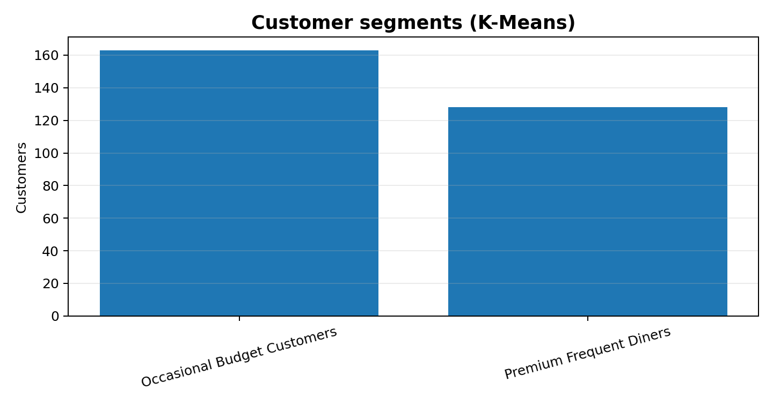
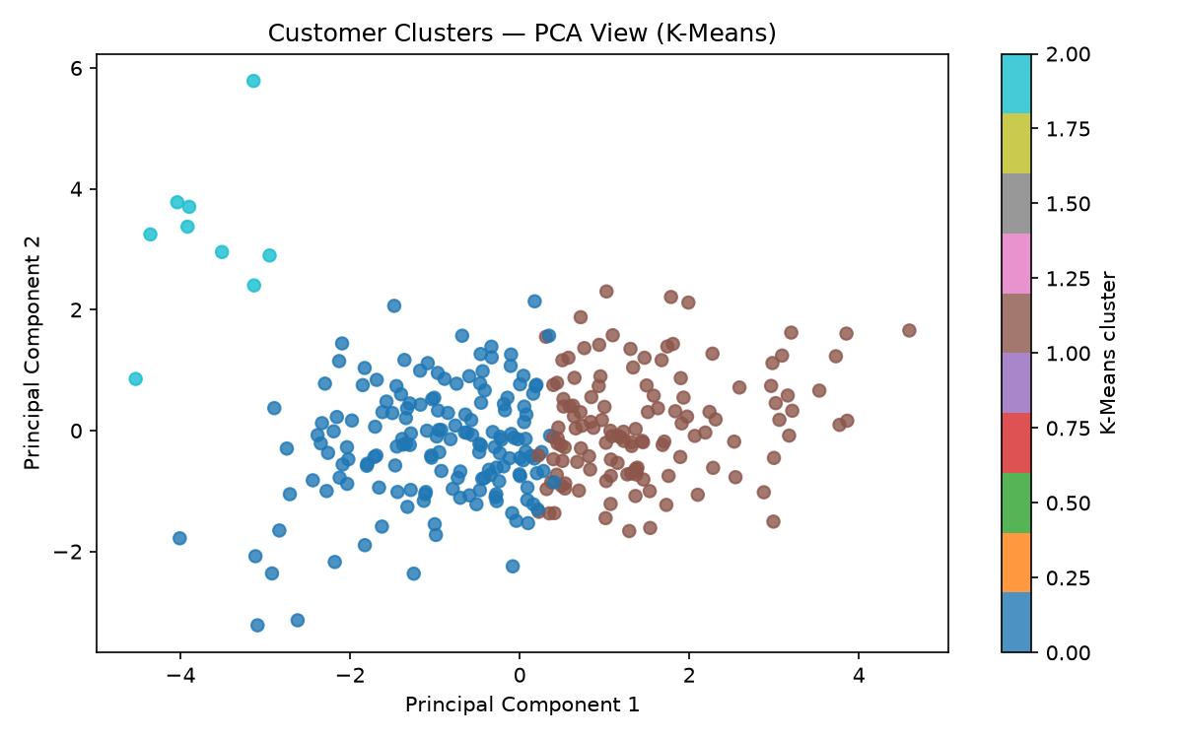
UBER EATS • CAPSTONE
Customer segmentation: three behavioural groups
Cluster sizes: 163 (54.3%) Occasional Budget Customers • 128 (42.7%) Premium Frequent Diners • 9 (3.0%) small third cluster. The third cluster's frequency feature appears inconsistent with its low total-order count; validate feature engineering before assigning a business interpretation.
Synthetic demonstration data • Results from supplied project outputs
06

Slide 7
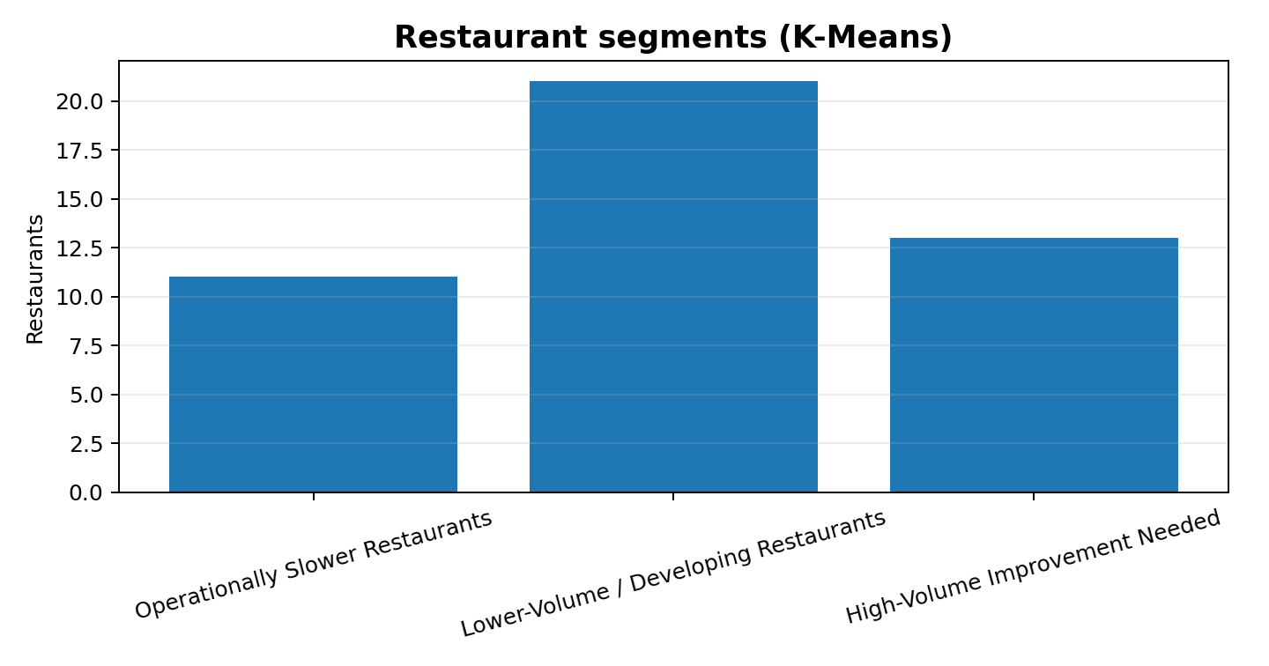
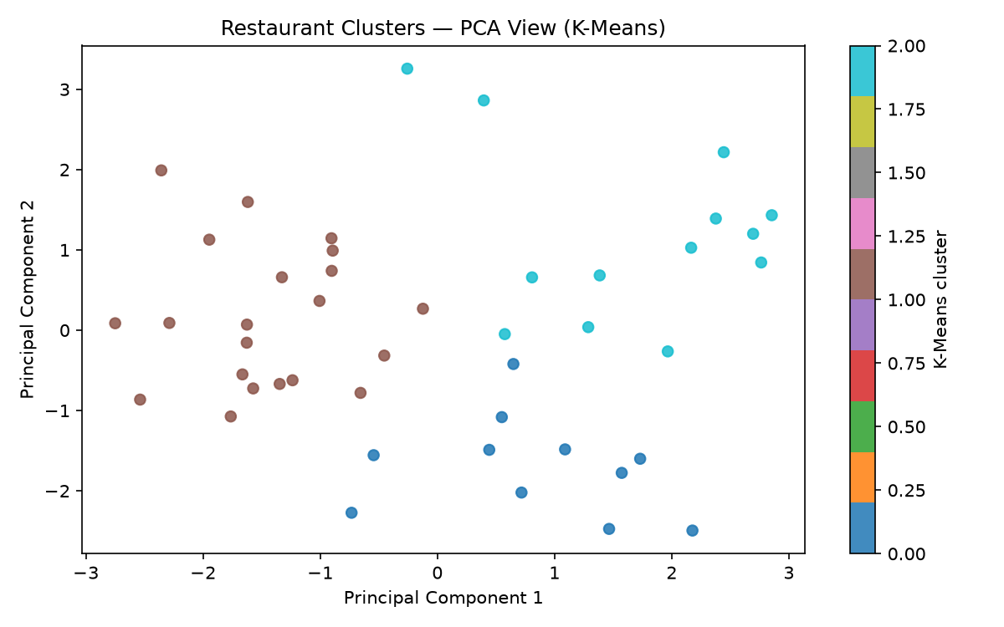
UBER EATS • CAPSTONE
Restaurant segmentation: operational profiles
11 restaurants (24.4%) are labelled Operationally Slower (avg prep 28.18 min; rating 3.53). 21 (46.7%) are Lower-Volume / Developing (prep 15.14 min; rating 3.86). 13 (28.9%) are High-Volume Improvement Needed (avg orders 46.85; rating 3.46). Profiles are descriptive, not causal diagnoses.
Synthetic demonstration data • Results from supplied project outputs
07

Slide 8
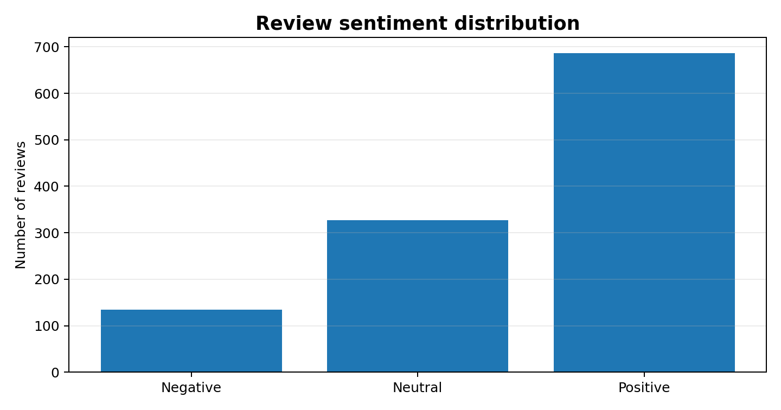
UBER EATS • CAPSTONE
Customer feedback: sentiment distribution
POSITIVE
NEUTRAL
686
327
59.8%
28.5%
NEGATIVE
Average rating
3.67 / 5
134
11.7%
Most frequent negative-review terms include food, packaging, damaged, support, slow, delivery, late and cold. Treat these as exploratory themes and inspect original comments before action.
Synthetic demonstration data • Results from supplied project outputs
08

Slide 9
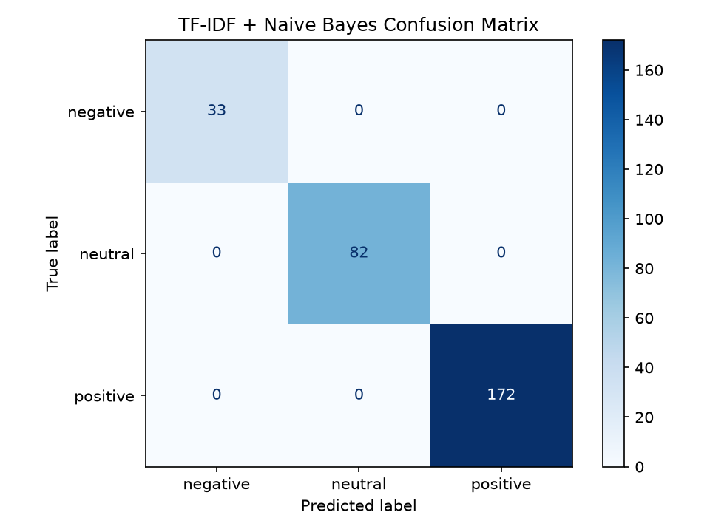
UBER EATS • CAPSTONE
NLP model: perfect score, important caveat
ACCURACY
WEIGHTED F1
TRAIN/TEST SPLIT
UNIQUE REVIEW TEXT
100%
1.000
75 / 25
11
Saved test metric
TF-IDF + MultinomialNB
Stratified random split
Across 1,147 reviews
Interpretation
The model exactly matched rating-derived labels on the saved test split. However, the dataset contains only 11 unique review-text templates repeated across 1,147 rows. A random split can place the same text templates in train and test, inflating performance.
Conclusion: do not claim 100% real-world sentiment accuracy. Re-evaluate with more diverse, human-labelled reviews and a template/group-aware split.
Synthetic demonstration data • Results from supplied project outputs
09

Slide 10
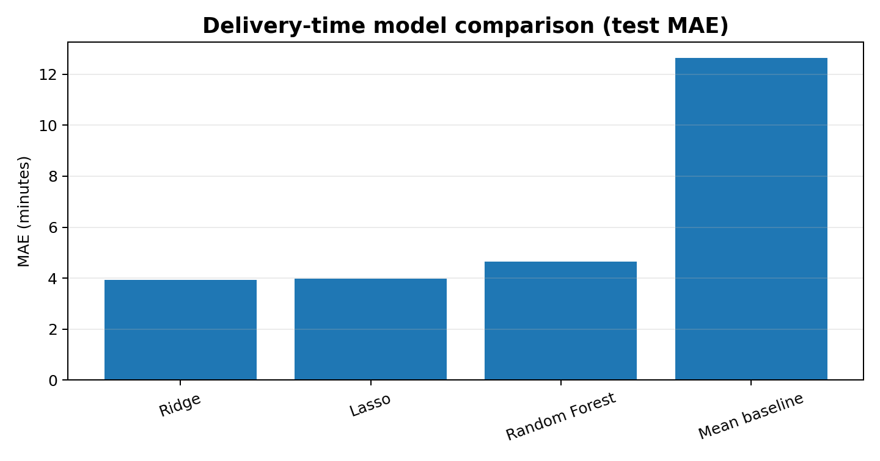
UBER EATS • CAPSTONE
Delivery-time prediction: Ridge performed best
BEST MODEL
TEST MAE
Ridge
3.94 min
Lowest test MAE
vs 12.63 baseline
TEST RMSE
TEST R²
4.94 min
0.906
Ridge
Ridge
5-fold CV: Ridge MAE 3.97 ± 0.09 min; mean CV R² 0.899. Lasso is very close (MAE 3.96 min).
Synthetic demonstration data • Results from supplied project outputs
10

Slide 11
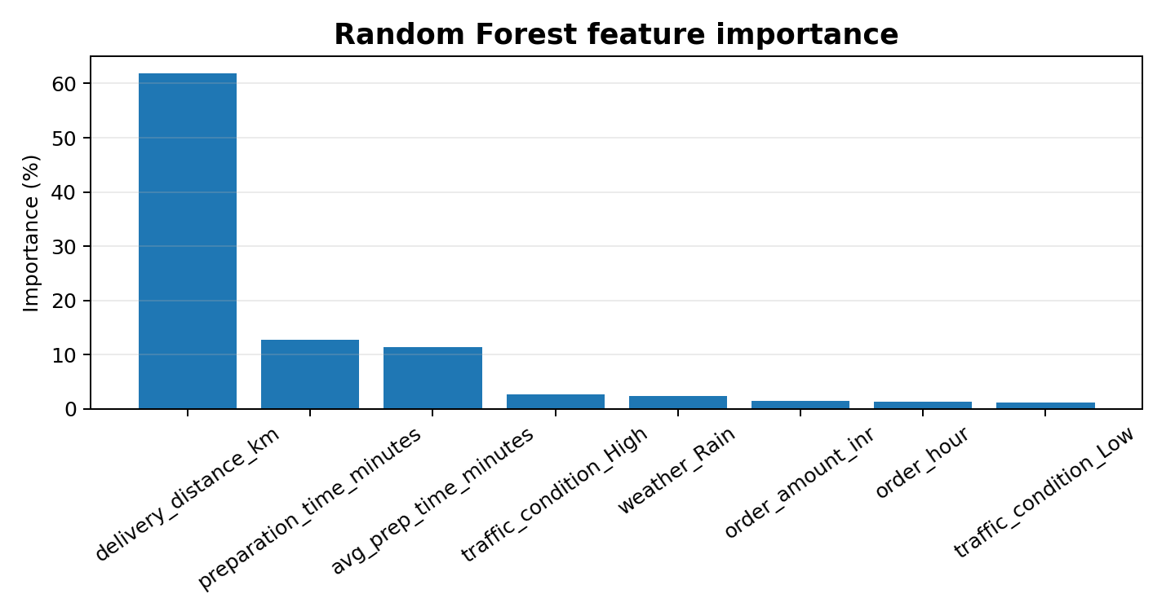
UBER EATS • CAPSTONE
Delivery-time drivers: what the model learned
TOP RANDOM FOREST IMPORTANCE
Delivery distance: 61.9%
Preparation time: 12.8%
Restaurant average prep time: 11.5%
High traffic: 2.6%
Rain: 2.5%
Importance is model-specific, not proof of causation.
Synthetic demonstration data • Results from supplied project outputs
11

Slide 12
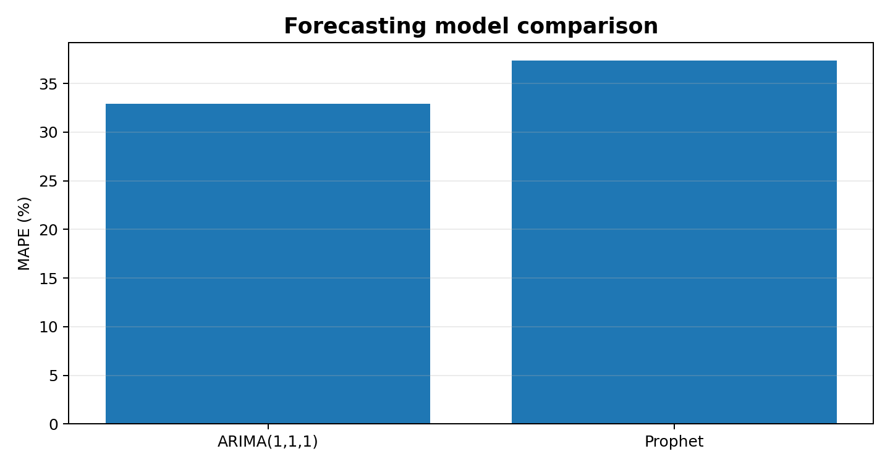
UBER EATS • CAPSTONE
Hourly demand forecasting: model comparison
ARIMA MAE
PROPHET MAE
0.75
0.75
RMSE 0.91
RMSE 0.92
ARIMA MAPE
PROPHET MAPE
32.93%
37.34%
Slightly lower
Higher error
Next 24-hour forecast is nearly flat at approximately 0.78–0.79 orders per hour. Despite ARIMA's marginal edge, the high MAPE and flat forecast mean this result is not yet strong enough for operational staffing decisions.
Synthetic demonstration data • Results from supplied project outputs
12

Slide 13
UBER EATS • CAPSTONE
Business implications: convert analysis into action
CUSTOMERS
Test targeted loyalty and retention offers for the larger customer groups; validate the small third cluster before targeting.
RESTAURANTS
Review prep-time and rating patterns with restaurant-level records; prioritize investigation, not automatic penalties.
CUSTOMER EXPERIENCE
Audit recurring negative themes—packaging, damaged items, slow delivery and support—against original review examples.
DELIVERY OPERATIONS
Pilot distance- and prep-time-aware ETA estimates; monitor errors on new deliveries.
RIDER CAPACITY
Improve forecasting data and validate against actual demand before using forecasts for shift planning.
Synthetic demonstration data • Results from supplied project outputs
13

Slide 14
UBER EATS • CAPSTONE
Limitations & validation required before deployment
All records are synthetic; results do not represent actual Uber Eats operations.
Sentiment labels are derived from ratings, and repeated review templates likely inflate the 100% test score.
Customer segment 3 has a suspicious frequency statistic relative to its order count; verify feature calculation.
Forecast MAPE is high and future hourly predictions are almost constant; improve series coverage and model diagnostics.
Feature importance and correlations do not establish causality.
Tip prediction is not included as a separately trained and evaluated model.
Synthetic demonstration data • Results from supplied project outputs
14

Slide 15
UBER EATS • CAPSTONE
Future scope: from proof of concept to robust solution
Replace synthetic records with approved, privacy-protected operational data.
Collect diverse reviews and human-annotated sentiment labels; validate with group-aware and time-based splits.
Revisit customer features, especially order-frequency calculations; validate cluster stability and business usefulness.
Improve demand forecasting with longer time history, seasonal baselines and rolling-origin backtesting.
Deploy monitored ETA and demand services; track model drift, forecast error and operational impact.
Synthetic demonstration data • Results from supplied project outputs
15

Slide 16
CLOSING SUMMARY
A connected analytics workflow—from customer behaviour to operational planning.
Segmentation provides an initial view of customer and restaurant groups.
Delivery-time regression shows promising synthetic test performance (Ridge MAE 3.94 min).
Sentiment and forecasting results need stronger validation before real-world use.
Business value comes from testing recommendations against real operational outcomes.
Thank you | Questions

